Slide 1
Annual Interagency Accessibility Forum
Unlocking the Power of Accessibility
October 11-13, 2022
Striving for Universal Access: Image Descriptions at the National Gallery of Art
Lorena Bradford, Accessible Programs & Projects, Education Division
Deanna Wood, User Experience Designer, Digital Product & Experience

Slide 2
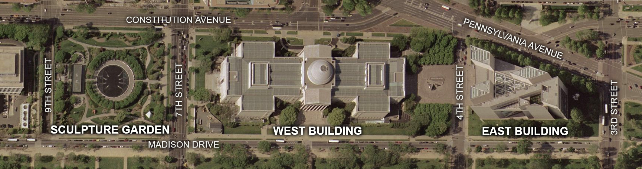
The National Gallery of Art

Slide 3
Short descriptions for the website
What they are
Where they live
How they are accessed
Timeline
Pilot phase: summer 2020
Expanding opportunities
Making the descriptions available to all

Slide 4
Goals of the project
Generating textual descriptions/alternative format for visual information
Training authors to write descriptions, which builds buy-in, passion, and capacity in an ever-growing group of colleagues and volunteers across every department of the museum
Packaging the training/onboarding system to offer to others (other museums, institutions, businesses)

Slide 5
Onboarding process
Introduction and informational overview (60 minutes)
Authors draft two descriptions; I provide feedback
Authors attend an interactive workshop (2 hours) where we edit a description draft together
On their own timeline to continue writing

Slide 6
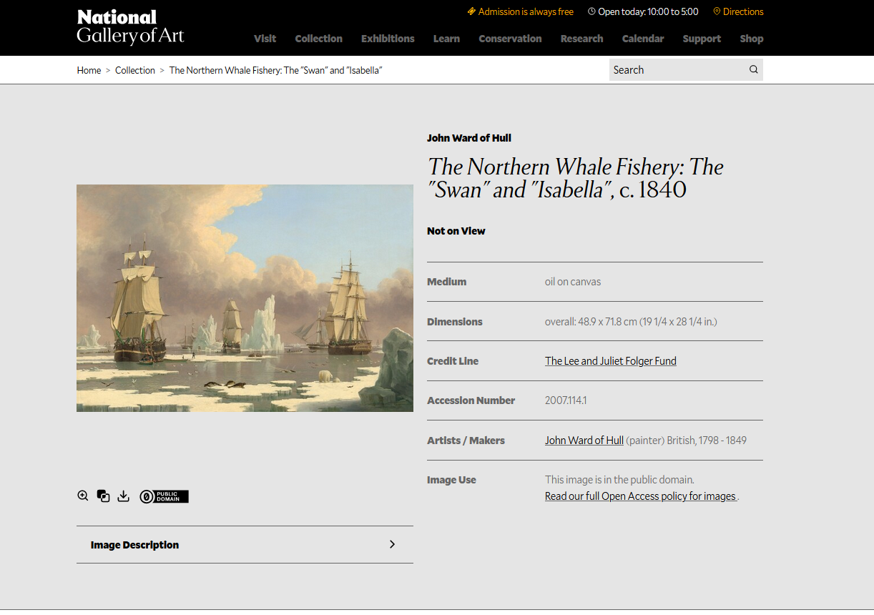
Webpage Example 1

Slide 7
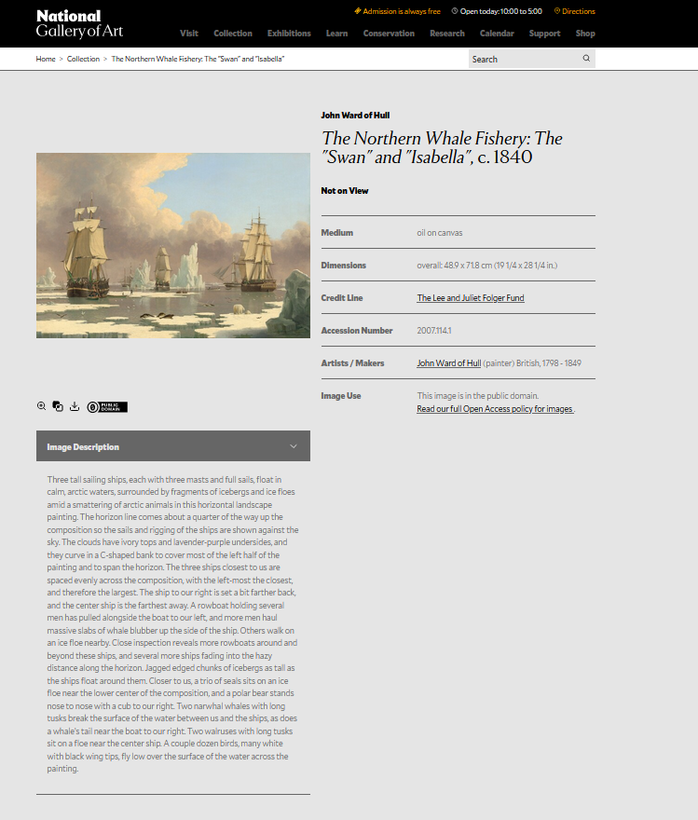
Webpage Example 2

Slide 8







UX Research and Design Process
Empathize
Define
Ideate
Prototype
Test
Define user personas and priority audiences
Conduct user research
Brainstorm design solutions and areas for user centered innovation
Design low fidelity wireframes
Design high fidelity clickable prototypes
Develop user testing plan
Evaluate design solutions with real life users
Define the problem or challenge
Identify user goals, pain points and opportunities

Slide 9
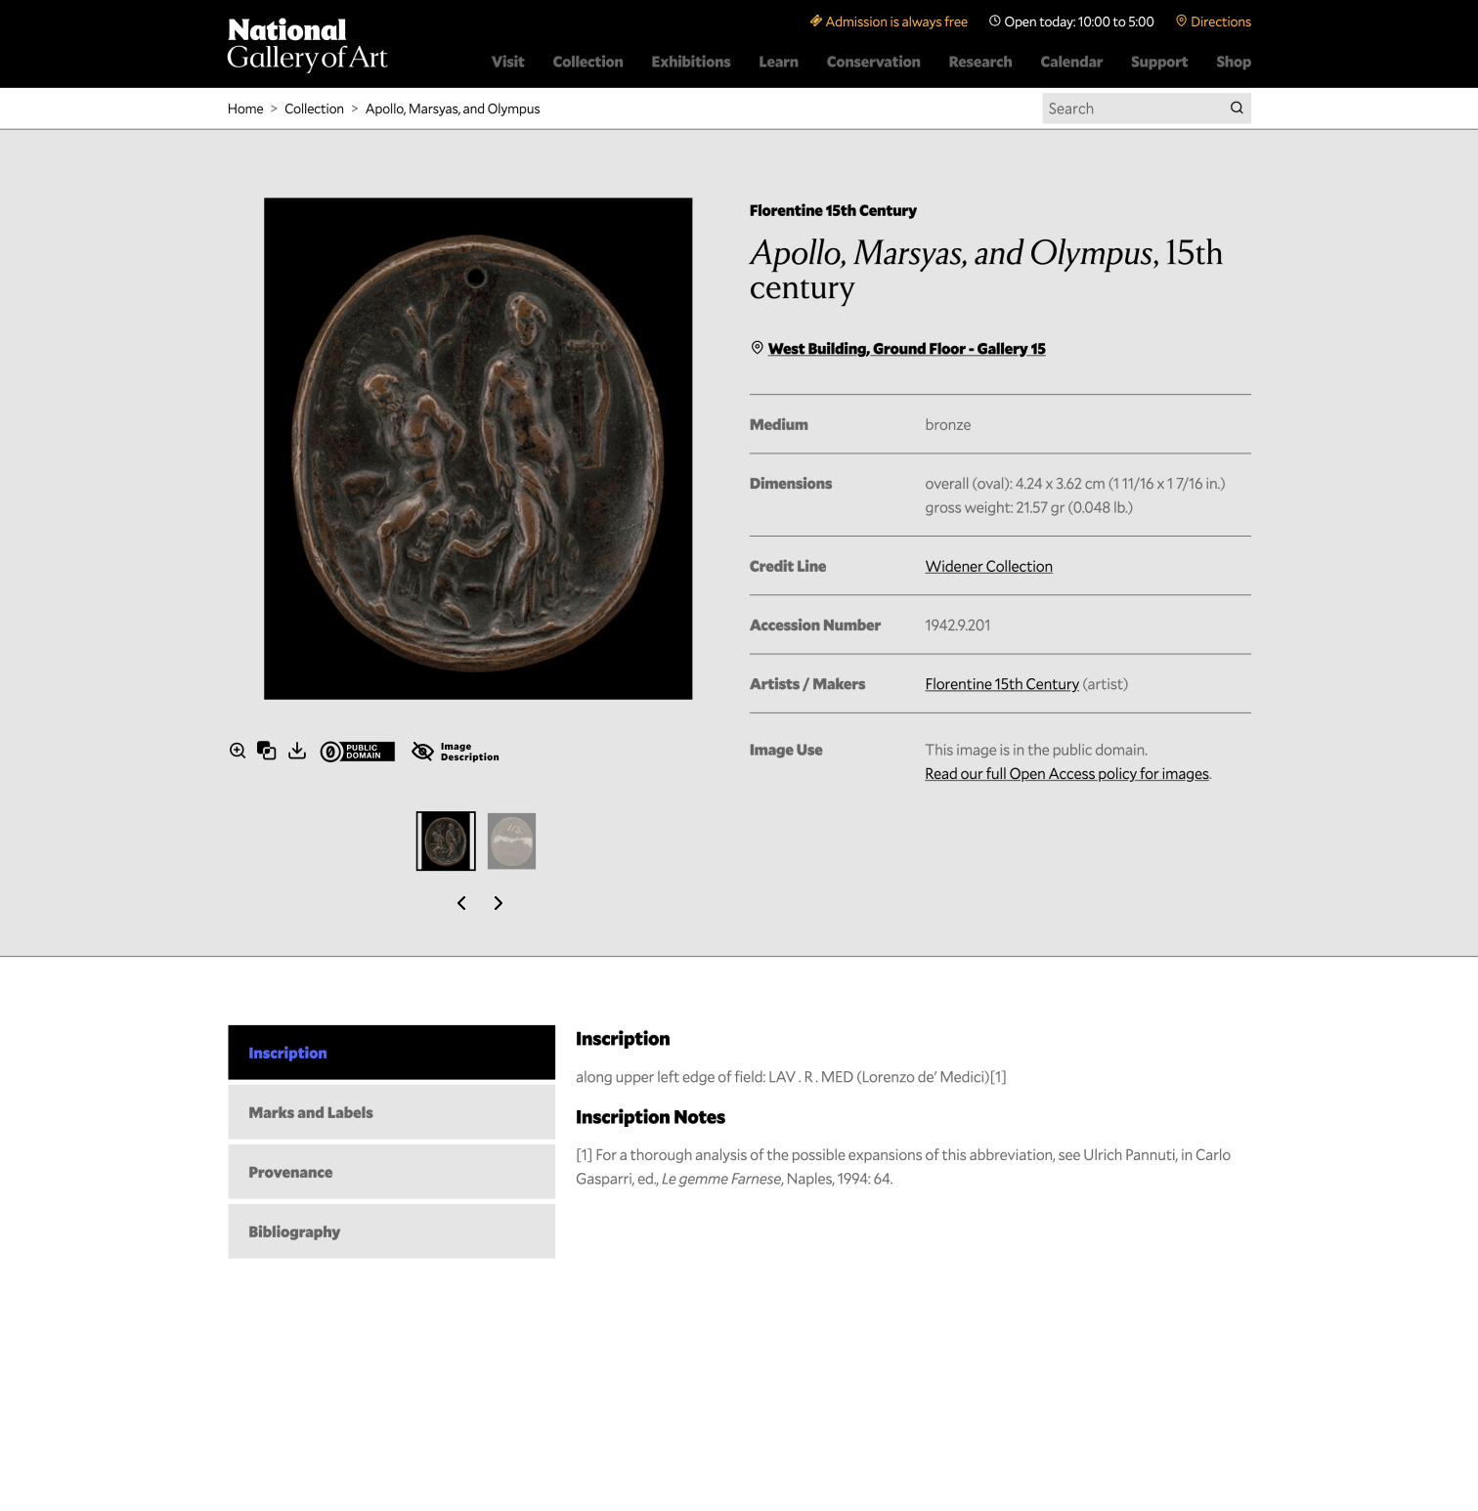
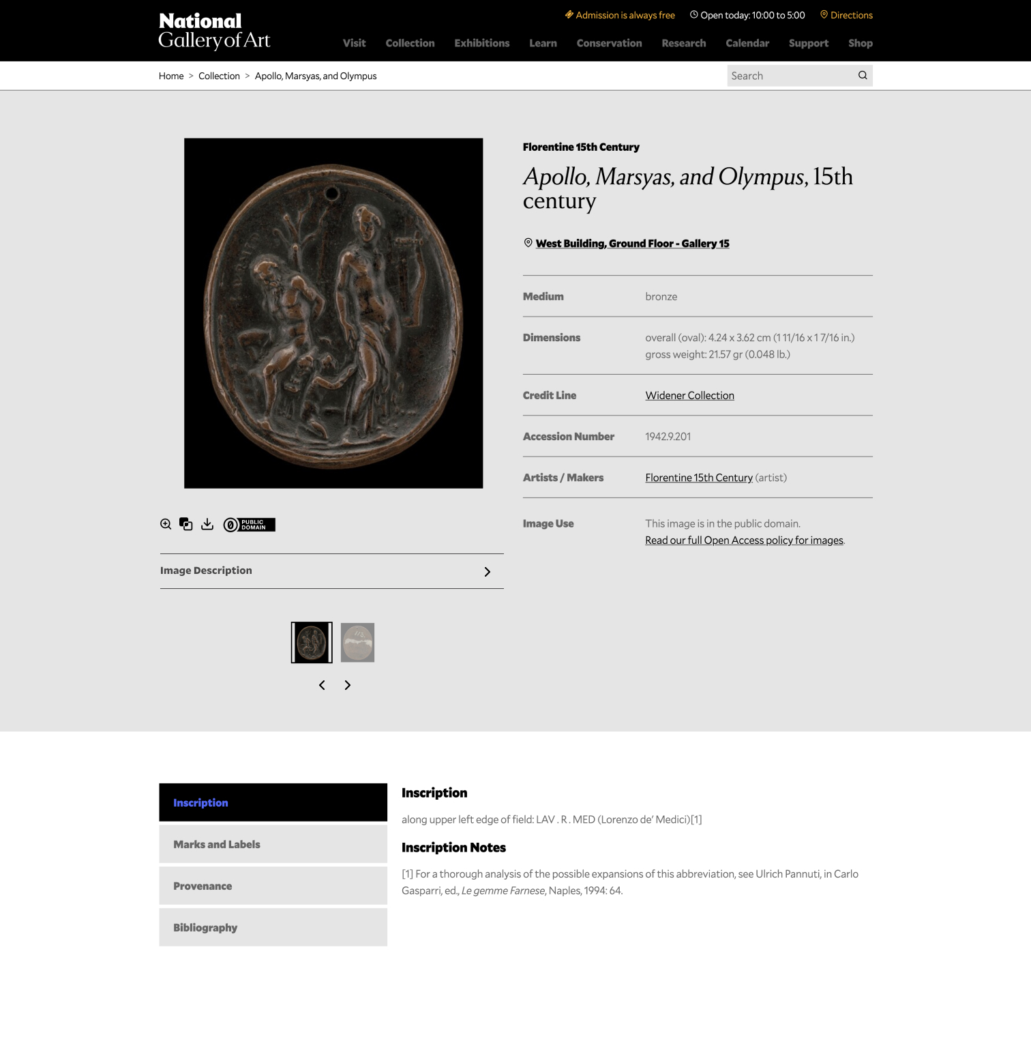
Design Phase

Slide 10
User Testing Phase
Test One: Low Vision and Blind Users
Determine the usability and access of the image descriptions for screen readers and other assistive technology
Moderated remote sessions over Zoom and Microsoft Teams
Test Two: Sighted Users
Determine the usability and accessibility of the image descriptions displayed on the front end for sighted users
Unmoderated recorded sessions through UserTesting.com tool

Slide 11
Test One Findings
8 Participants
60% Screenreader/JAWS
40% Keyboard/VoiceOver
Accessing Image Description
50% No issues
25% User issues
25% Usability issues
Content Feedback Quotes
“I liked the mention of the animals and tiny details in the painting. It was very good. I can zoom into the painting, to confirm details that are being described that I might have missed.”
- App reader and magnifier/keyboard user

Slide 12
Test Two Findings
20 Participants (10 Desktop/ 10 Mobile)
100% able to access descriptions
80% expected to find the tombstone data instead
Majority of users had a positive experience reading the description
Experience Feedback Quotes
“It does impact my experience…it brings the artwork to life and really defines the analogy that there is more than meets the eye.”
- Mobile user

Slide 13
Additional Usability Insights
Ability to skip navigation
Zoom functionality with browser magnification tool
Proper header structure on webpage
Content structure expectation

Slide 14
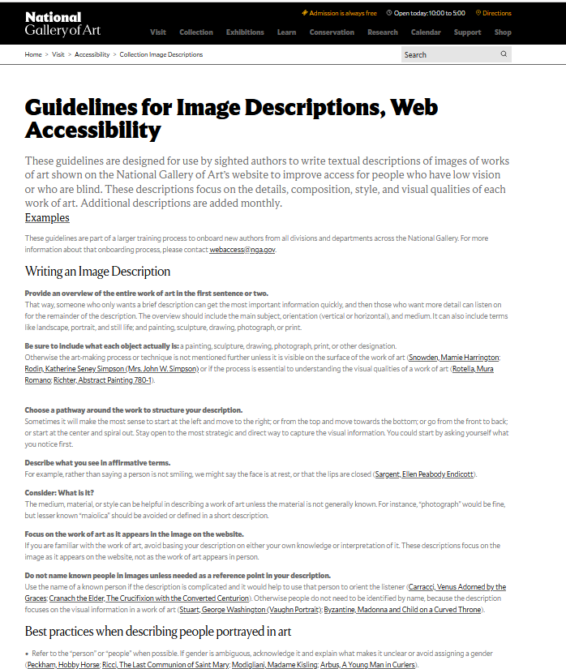
Resources for you! (We hope)
Guidelines: https://www.nga.gov/visit/accessibility/collection-image-descriptions.html
Examples: https://www.nga.gov/visit/accessibility/collection-image-descriptions/short-description-examples.html

Slide 15
Thank you! webaccess@nga.gov

